Slide 1
Best 11 squad using python
Sourish Hazra
Indrasish Kundu
Sayan Ghosh
Nilayan Ghosh
Arko Mitra

Slide 2
Overview and What will It do
Calculate the best possible team from player stats.
Mostly the data is taken from Kaggle.
The squad is built on a 4-3-3 formation taken in consideration on the availability of players.
Players would be selected from the top 28 teams.
It would select 4 top class defenders, 3 top class midfielders,3 top class strikers.

Slide 3
INTRODUCTION
Football is the most popular sport in the planet and competitions like Euro , Copa America and the World Cup makes it more exciting.
FIFA Word Cup has once again arrived where the best of the best players will survive and eventually win.
Everybody has a dream about creating a squad based on their favorite players .
So we have created a squad builder based on the player stats.
Results may vary from User to user.

Slide 4
PACKAGES USED:
Pandas : Pandas is used to read the csv files
Matplotlib and Seaborn: It is used for creating graphs

Slide 5
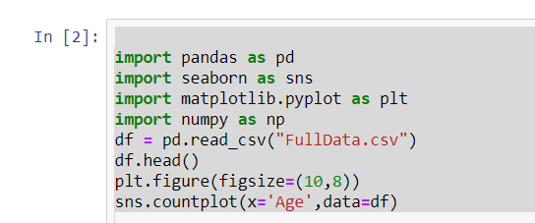
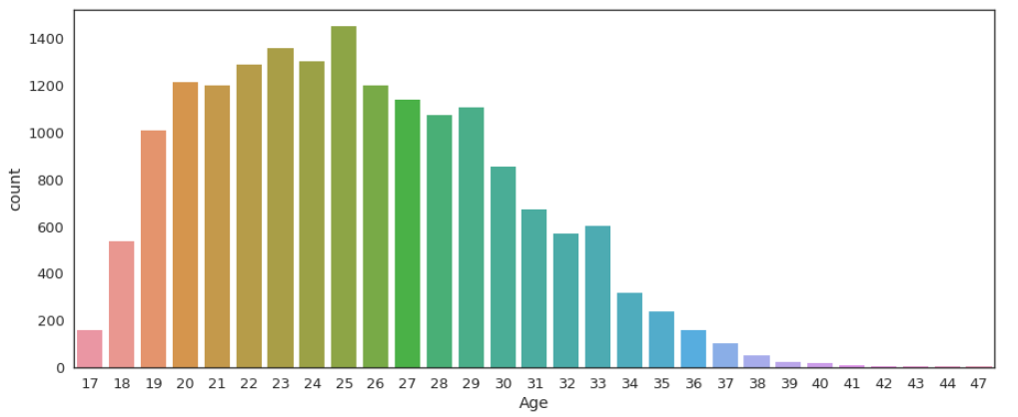
Graph based on player’s age

Slide 6
Finding The Best Goalkeeper
In order to get the best goalkeeper, we’ll be analyzing the data for the below mentioned parameters:
Shot Stopper: A goalkeeper who is strong in stopping shots taken by opponents.
Sweeper: A goalkeeper who is strong in playing with his feet and making passes.

Slide 7
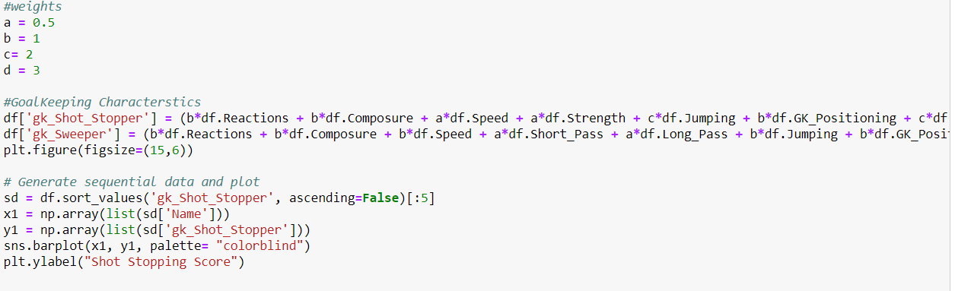
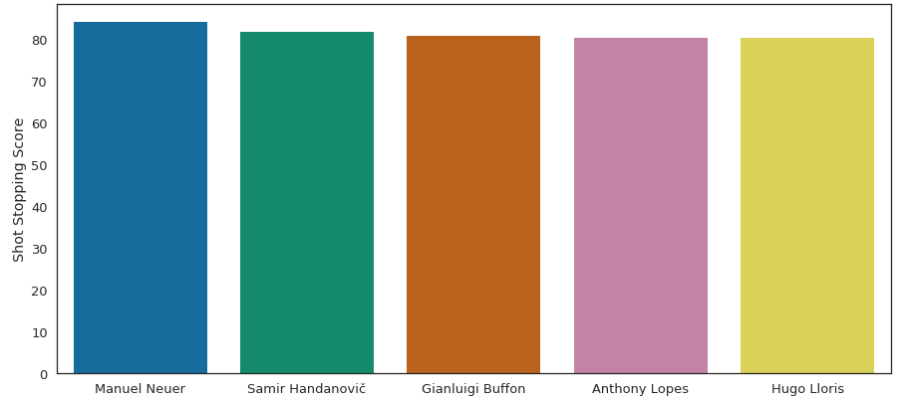

Slide 8
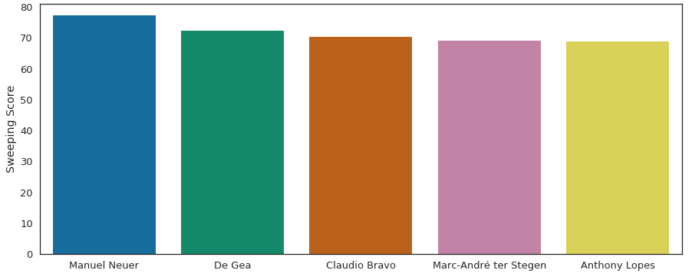
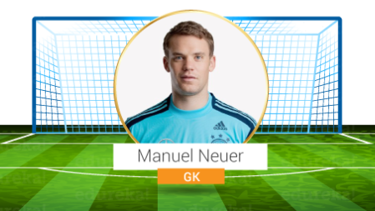
Verdict - Manuel Neuer tops the chart here as well. Based on the two parameters we used, we can conclude that Manuel Neuer would be the best choice goalkeeper for the World Cup 2018.

Slide 9
Finding The Best Defenders
In order to find the best defenders, I’ll be using following attributes to fetch the best defenders:
Centre Backs: We need two center-backs. One who plays LCB and the other who plays RCB.
Wing Backs: We again need two wing backs. One who plays on the Left and the other who plays on the right.

Slide 10
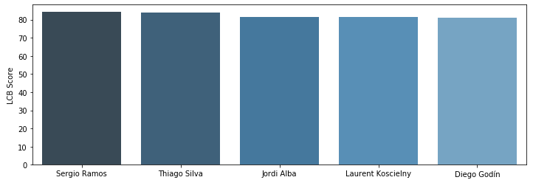
LEFT CENTRAL DEFENDER:
Verdict:Based on the left center back characteristics, it can be inferred that Sergio Ramos is the Best Left Central Defender.

Slide 11
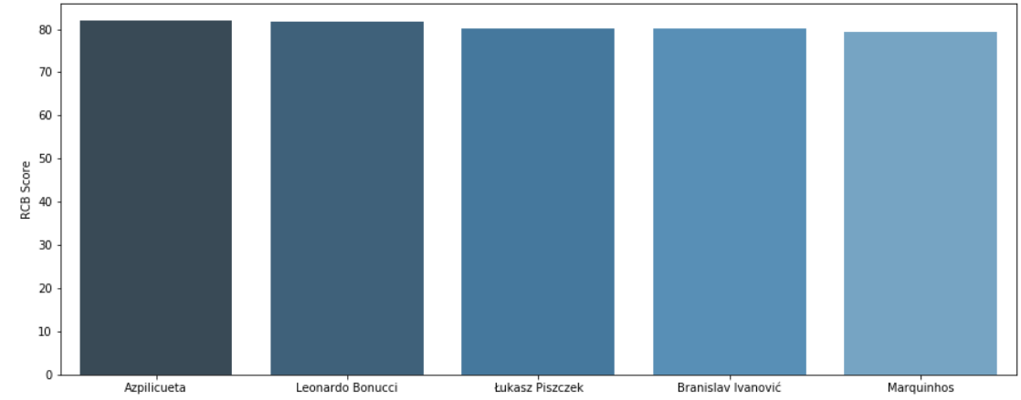
RIGHT CENTRAL DEFENDER:

Slide 12
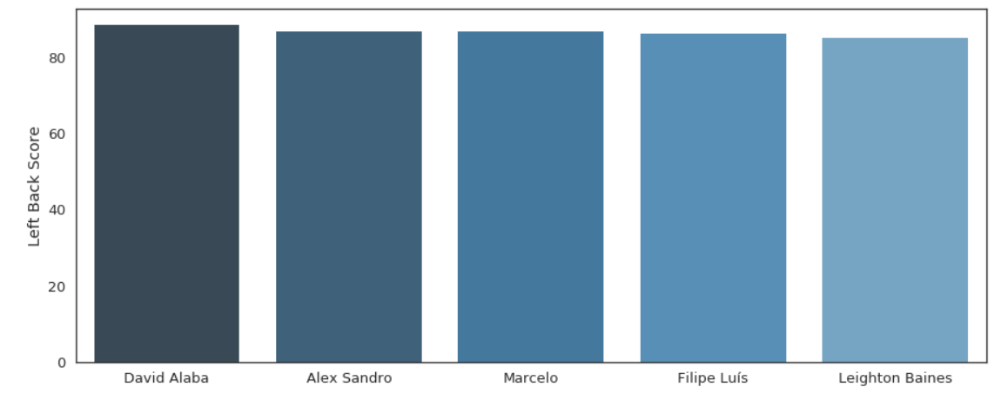
LEFT WING BACK:

Slide 13
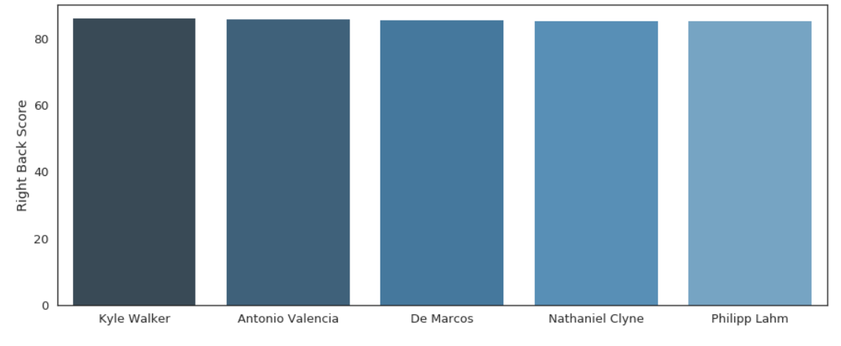
RIGHT WING BACK:

Slide 14
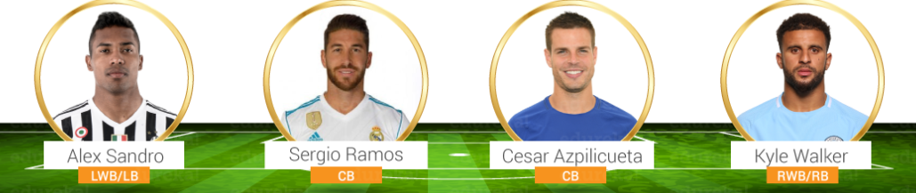

Slide 15
Finding the best midfielder:
As per my game formation 4-3-3, I have to choose 3 midfielders. In order to find these, I’ll be analyzing the data for the below mentioned parameters:
Playmaker: A playmaker is someone who will move the ball to the attacking 3rd from defense or midfield.
Beast: A beast is a typical box-to-box player with loads of energy and who can boss the midfield.
Controller: A controller is the person who is orchestrating your midfield engine by either sitting back or going forward based on dynamic needs.

Slide 16
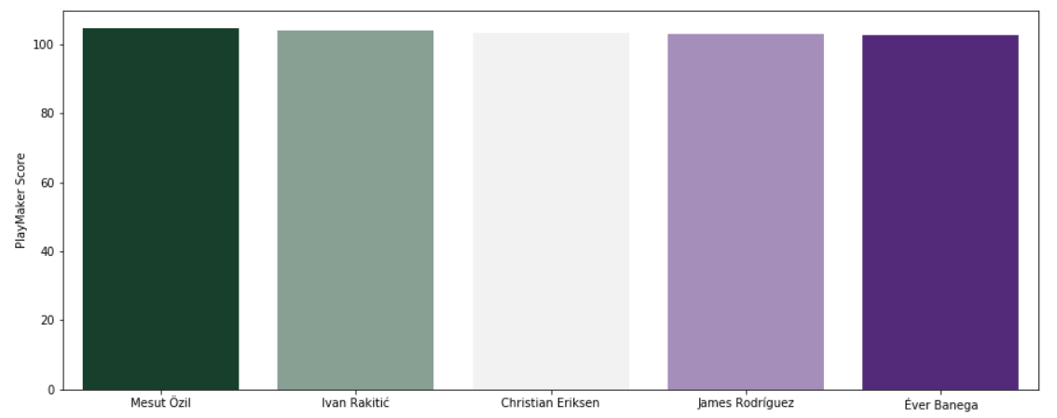
Playmaker:

Slide 17
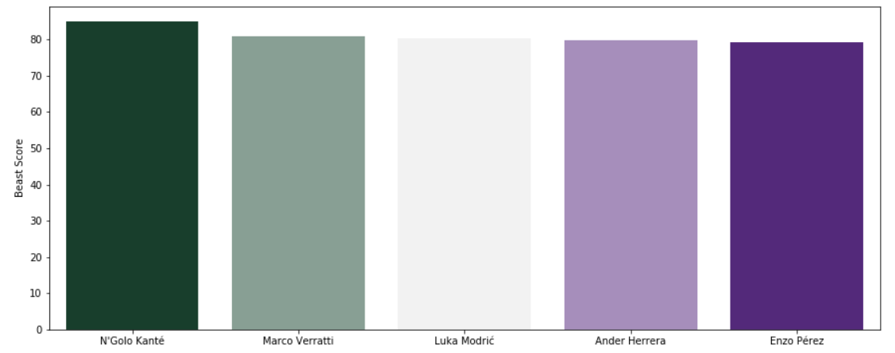
Beast:

Slide 18
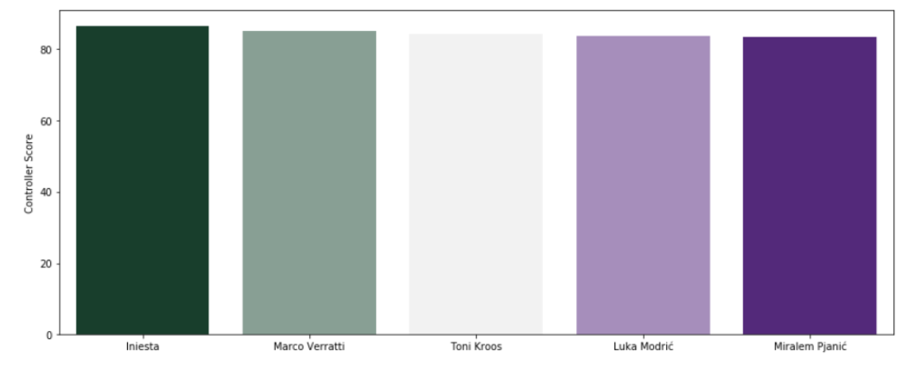
Controller:

Slide 19
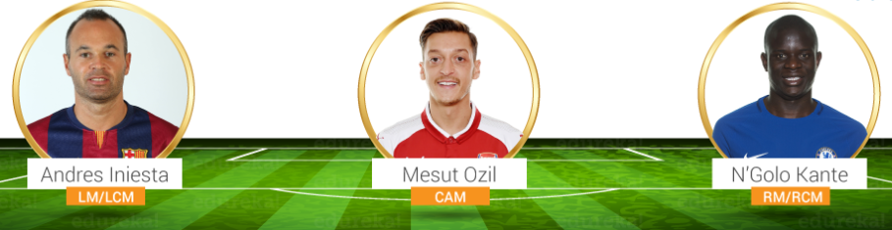

Slide 20
Finding the best striker:
In order to find the best attacker, I’ll be analyzing the below mentioned parameters:
Attacking Left Wing: He is a player, attacking from the left flank.
Attacking Right Wing: He is a player, attacking from the right flank.
Striker: He is a player attacking from the center.

Slide 21
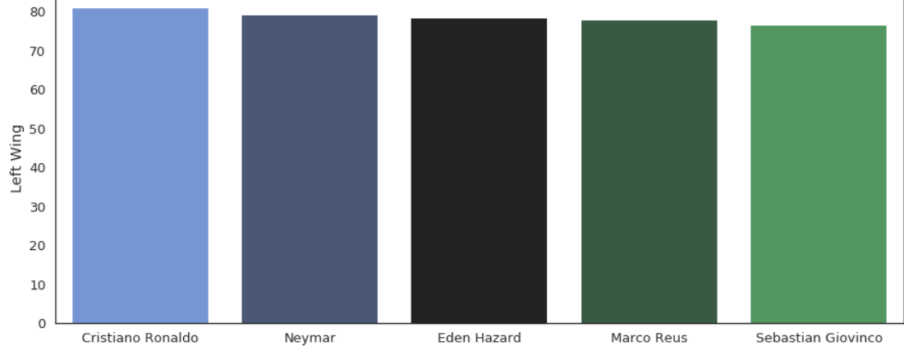
Attacking left wing:

Slide 22
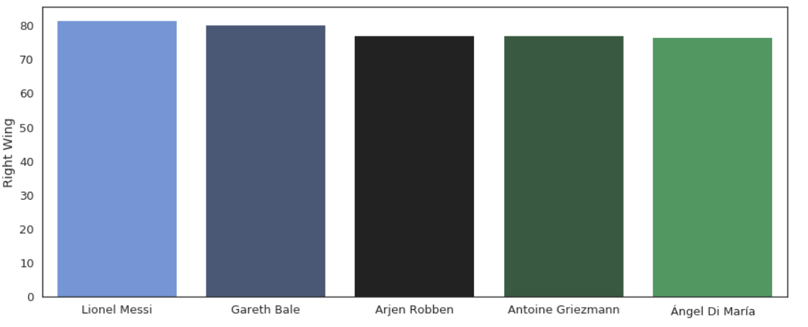
Attacking right wing:

Slide 23
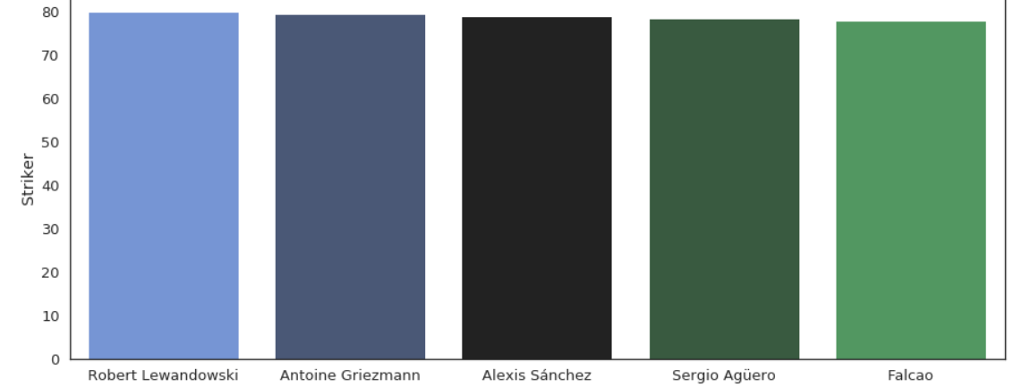
Striker:

Slide 24
Conclusion
We sincerely thank our respective coaching instructor Himalaya mondal and our fellow batchmates

